Slide 1
C-5 Fuel cell facility 167th airlift wing martinsburg, wv
Kyle Goodyear
BAE in Construction Management
Pennsylvania State University
Senior Thesis Presentation
April 12, 2010

Slide 2
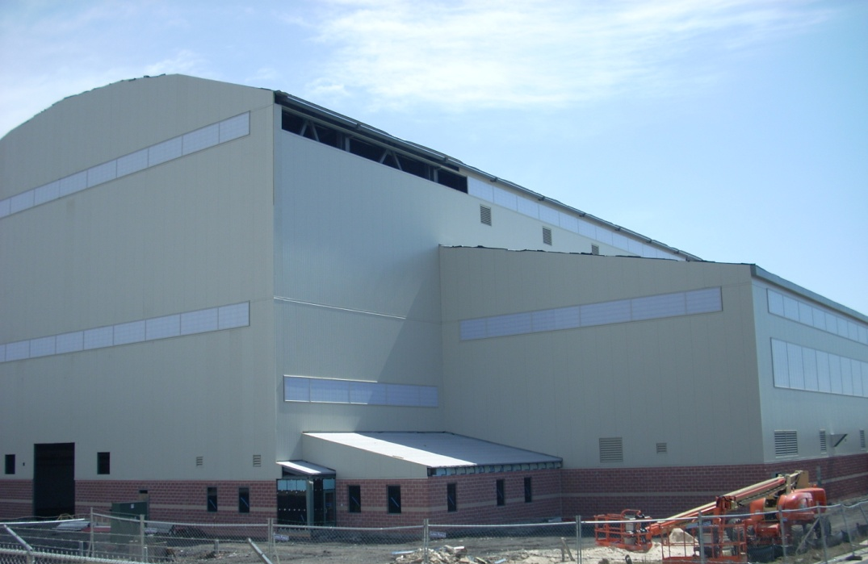
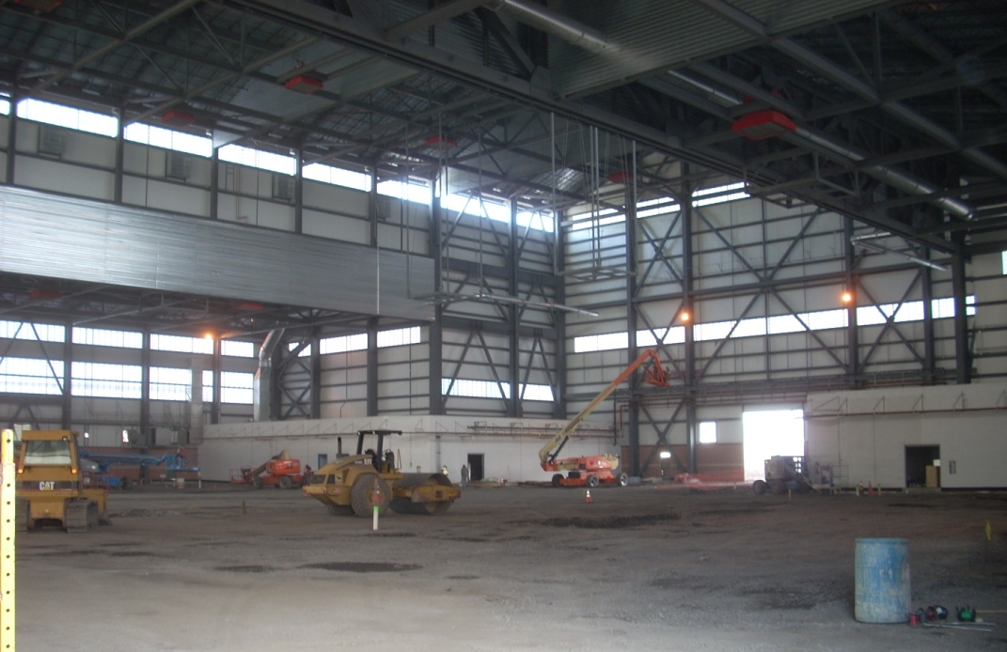
Presentation Outline
Special Thanks to:
Kinsley Construction, Inc.
167th Airlift Wing
Penn State AE Faculty
Project Background Information
Solar Energy Collection
Electrical Breadth
Precast Concrete Walls
Structural Breadth
Hangar Slab Sequence
Design/Build Productivity
Conclusions
Questions and Answers

Slide 3
Project Background
Presentation Outline
Client: 167th Airlift Wing – WV Air National Guard
Project Background Information
Solar Energy Collection
Electrical Breadth
Precast Concrete Walls
Structural Breadth
Hangar Slab Sequence
Design/Build Productivity
Conclusions
Questions and Answers
Site: Martinsburg, WV
WV Eastern Regional Airport
Purpose
C-5 Galaxy Conversion Project

Slide 4
Project Background
Presentation Outline
167th Airlift Wing
Owner
Design/Build Contract
Kinsley Construction – Design/Build Manager
Holds all subcontracts
LSC Design – contracted by Kinsley Construction
Holds all design team subcontracts
All contracts based on lump sum
Project Background Information
Solar Energy Collection
Electrical Breadth
Precast Concrete Walls
Structural Breadth
Hangar Slab Sequence
Design/Build Productivity
Conclusions
Questions and Answers
Kinsley Construction
LSC Design
Subcontractors
Design Team

Slide 5
Project Background
Presentation Outline
Cost: $26.8 million
Project Background Information
Solar Energy Collection
Electrical Breadth
Precast Concrete Walls
Structural Breadth
Hangar Slab Sequence
Design/Build Productivity
Conclusions
Questions and Answers
Schedule
NTP for design: October 2008
Office Mobilization: March 2009
Scheduled Completion: March 2010
Expected Completion: July 2010 – extensions granted for additions to scope and weather delays

Slide 6
Breadth Topics
Presentation Outline
Electrical Breadth Study
Addition of solar collection system
Project Background Information
Solar Energy Collection
Electrical Breadth
Precast Concrete Walls
Structural Breadth
Hangar Slab Sequence
Design/Build Productivity
Conclusions
Questions and Answers
Structural Breadth Study
Design of load-bearing concrete walls in place of masonry

Slide 7
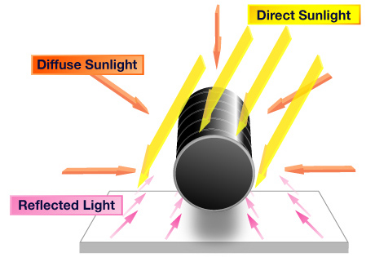
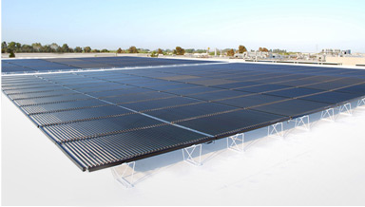
Solar Energy Collection
Presentation Outline
Goal of Analysis
Determine if the installation of Solyndra panels is a positive addition
Potential energy production
Building power usage
Purchase and installation costs
Payback period
Project Background Information
Solar Energy Collection
Electrical Breadth
Precast Concrete Walls
Structural Breadth
Hangar Slab Sequence
Design/Build Productivity
Conclusions
Questions and Answers

Slide 8
Solar Energy Collection
Presentation Outline
Solyndra, Inc. Panels
Array of cylinders
Collects direct, diffuse, and reflected light
Reflected light gain based on roof material
Airflow between cylinders
Reduced wind uplift
Cooler operating temperatures
Project Background Information
Solar Energy Collection
Electrical Breadth
Precast Concrete Walls
Structural Breadth
Hangar Slab Sequence
Design/Build Productivity
Conclusions
Questions and Answers

Slide 9
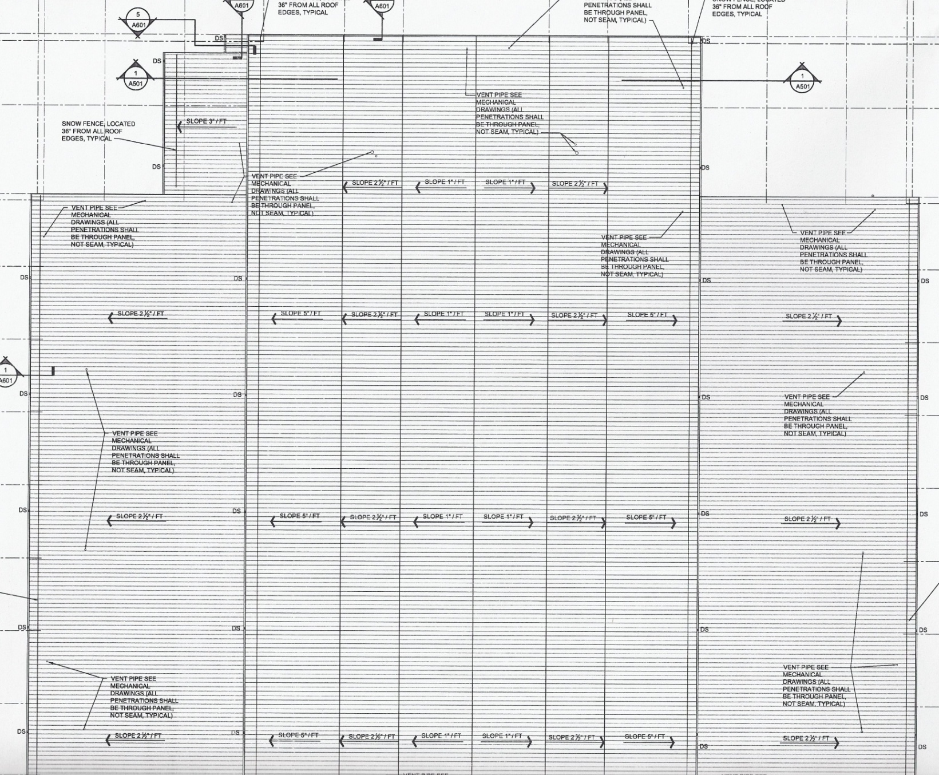
Electrical Breadth Study
Presentation Outline
How many Solyndra panels can be installed on the roof?
Orientation of building
Dimensions of panels vs. Dimensions of roof
Project Background Information
Solar Energy Collection
Electrical Breadth
Precast Concrete Walls
Structural Breadth
Hangar Slab Sequence
Design/Build Productivity
Conclusions
Questions and Answers
3 sections of usable roof space on SW side
13 panels lengthwise along slope of roof
78 panels across the roof
1014 panels total

Slide 10
Electrical Breadth Study
Presentation Outline
Energy Production Potential
Power Rating of Solyndra panel
Monthly insolation values for location
Max annual output: 274 kWh/panel
Reflectivity reduction: 88%
Potential annual output: 241 kWh/panel
241kWh/panel/year x 1014 panels = 244,374 kWh/year
Project Background Information
Solar Energy Collection
Electrical Breadth
Precast Concrete Walls
Structural Breadth
Hangar Slab Sequence
Design/Build Productivity
Conclusions
Questions and Answers

Slide 11
Electrical Breadth Study
Presentation Outline
Building Energy Usage
Existing hangar energy usage
Average office energy usage
Total Expected Energy Usage = 213,773 kWh/year
Project Background Information
Solar Energy Collection
Electrical Breadth
Precast Concrete Walls
Structural Breadth
Hangar Slab Sequence
Design/Build Productivity
Conclusions
Questions and Answers
Cost of Installing Solyndra System
$7 per Watt per panel
$7/W/panel x 200W x 1014 panels
$1,419,600 to purchase and install

Slide 12
Electrical Breadth Study
Presentation Outline
Payback Period of System
Cost of electricity: 6.64 cents per kWh in WV
Expected savings plus sale of electricity
$0.0664/kWh x 244,374 kWh/year = $16, 226/year
Project Background Information
Solar Energy Collection
Electrical Breadth
Precast Concrete Walls
Structural Breadth
Hangar Slab Sequence
Design/Build Productivity
Conclusions
Questions and Answers
$1,419,600 / $16,226/year = 87.5 years

Slide 13
Conclusion and Recommendation
Presentation Outline
System produces more than building uses
Payback period is extremely long
Low cost of energy for project location
More feasible in higher cost region
Project Background Information
Solar Energy Collection
Electrical Breadth
Precast Concrete Walls
Structural Breadth
Hangar Slab Sequence
Design/Build Productivity
Conclusions
Questions and Answers
Recommendation: Do not install Solyndra system on this project.

Slide 14
Precast Concrete Walls
Presentation Outline
Goal of Analysis
Is precast concrete a better option than CMU for wall construction?
Exterior façade
Interior load-bearing walls
Project Background Information
Solar Energy Collection
Electrical Breadth
Precast Concrete Walls
Structural Breadth
Hangar Slab Sequence
Design/Build Productivity
Conclusions
Questions and Answers

Slide 15
Precast Concrete Walls
Presentation Outline
Exterior Façade
Currently split-face CMU to match existing buildings
Carbon Cast panels
Thin-brick technology to match aesthetics
Produced in controlled conditions
Higher quality product than masonry
Project Background Information
Solar Energy Collection
Electrical Breadth
Precast Concrete Walls
Structural Breadth
Hangar Slab Sequence
Design/Build Productivity
Conclusions
Questions and Answers

Slide 16
Structural Breadth Study
Presentation Outline
Load Determination
Dead Load: 21.3 PSF
Live Load: 20 PSF
Project Background Information
Solar Energy Collection
Electrical Breadth
Precast Concrete Walls
Structural Breadth
Hangar Slab Sequence
Design/Build Productivity
Conclusions
Questions and Answers
P_{D} = 1193 lbs
P_{L} = 1120 lbs
P_{U} = 1.2P_{D} + 1.6P_{L} = 3223 lbs = 3.22 kips
Strength Design Method
Load combination: 1.2D + 1.6L
Total Axial Load = 3.22 kips

Slide 17
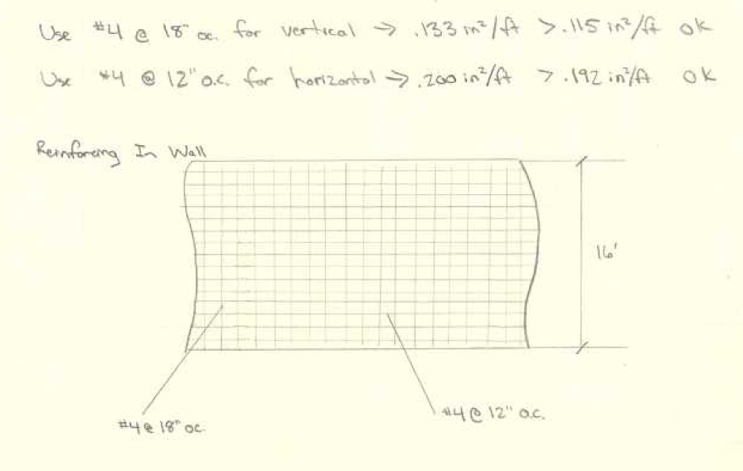
Structural Breadth Study
Presentation Outline
Using 8” wall thickness
Bearing Capacity
Axial Load Capacity
Project Background Information
Solar Energy Collection
Electrical Breadth
Precast Concrete Walls
Structural Breadth
Hangar Slab Sequence
Design/Build Productivity
Conclusions
Questions and Answers
Minimum Reinforcement
#4’s @ 18”oc in vertical direction
#4’s @ 12”oc in horizontal direction

Slide 18
Structural Breadth Study
Presentation Outline
Cost Comparison
Masonry package: $230,011
Precast package: $506,084
$38/SF estimate from High Concrete
Project Background Information
Solar Energy Collection
Electrical Breadth
Precast Concrete Walls
Structural Breadth
Hangar Slab Sequence
Design/Build Productivity
Conclusions
Questions and Answers
Increased Floor Space
Change from 12” masonry to 8” concrete walls
117 SF added at $340/SF
$39,720 worth additional usable space

Slide 19
Structural Breadth Study
Presentation Outline
MASONRY LOGISTICS PLAN
Schedule Comparison
Masonry package: 25 days on-site
Precast concrete package: 15 days on-site
Not on critical path: does not change project schedule
Project Background Information
Solar Energy Collection
Electrical Breadth
Precast Concrete Walls
Structural Breadth
Hangar Slab Sequence
Design/Build Productivity
Conclusions
Questions and Answers
Productivity Impact
Fewer workers for precast
More moving equipment for precast
PRECAST LOGISTICS PLAN

Slide 20
Conclusion and Recommendation
Presentation Outline
Cost of change is more than double
Overall schedule not reduced
Increased floor space
Higher quality facade
Project Background Information
Solar Energy Collection
Electrical Breadth
Precast Concrete Walls
Structural Breadth
Hangar Slab Sequence
Design/Build Productivity
Conclusions
Questions and Answers
Recommendation: Use the masonry system as designed instead of precast concrete option.

Slide 21
Hangar Slab Sequence
Presentation Outline
Goal of Analysis
Determine most efficient sequence for concrete placement in hangar area
Cost
Duration
Productivity
Project Background Information
Solar Energy Collection
Electrical Breadth
Precast Concrete Walls
Structural Breadth
Hangar Slab Sequence
Design/Build Productivity
Conclusions
Questions and Answers

Slide 22
Hangar Slab Sequence
Presentation Outline
Industry Survey
Larger pour size = higher productivity
Project Background Information
Solar Energy Collection
Electrical Breadth
Precast Concrete Walls
Structural Breadth
Hangar Slab Sequence
Design/Build Productivity
Conclusions
Questions and Answers
3 Sequences
As-built
More pours/smaller width
Less pours/greater width

Slide 23
Hangar Slab Sequence
Presentation Outline
Cost and Duration Comparison
Larger pour width costs less and completed faster
Smaller pour width costs more and completed slower
Project Background Information
Solar Energy Collection
Electrical Breadth
Precast Concrete Walls
Structural Breadth
Hangar Slab Sequence
Design/Build Productivity
Conclusions
Questions and Answers
Quality Comparison
Larger width makes finishing more difficult
Higher quality with smaller width pours

Slide 24
Conclusion and Recommendation
Presentation Outline
Quality vs. Cost
Hangar dimensions
Project Background Information
Solar Energy Collection
Electrical Breadth
Precast Concrete Walls
Structural Breadth
Hangar Slab Sequence
Design/Build Productivity
Conclusions
Questions and Answers
Recommendation: Employ the slab pour sequence that was chosen by project team.
Slightly larger pours if dimensions allow

Slide 25
Design/Build Productivity
Presentation Outline
Goal of Analysis
Does design/build construction increase productivity for the management and design team as well as in the field?
Project Background Information
Solar Energy Collection
Electrical Breadth
Precast Concrete Walls
Structural Breadth
Hangar Slab Sequence
Design/Build Productivity
Conclusions
Questions and Answers

Slide 26
Design/Build Productivity
Presentation Outline
Measurements
Preconstruction activity time
Paperwork during construction
Ability to work ahead
Project Background Information
Solar Energy Collection
Electrical Breadth
Precast Concrete Walls
Structural Breadth
Hangar Slab Sequence
Design/Build Productivity
Conclusions
Questions and Answers

Slide 27
Design/Build Productivity
Presentation Outline
Research Steps
Project Manager Survey
Owner Perspective
Causes of Delays
Potential Benefits
Project Background Information
Solar Energy Collection
Electrical Breadth
Precast Concrete Walls
Structural Breadth
Hangar Slab Sequence
Design/Build Productivity
Conclusions
Questions and Answers

Slide 28
Design/Build Productivity
Presentation Outline
Findings of Research
Preconstruction time reduced
Design is better the first time
Estimating is completed simultaneously
Subcontractors acquired earlier for design-assist
Project Background Information
Solar Energy Collection
Electrical Breadth
Precast Concrete Walls
Structural Breadth
Hangar Slab Sequence
Design/Build Productivity
Conclusions
Questions and Answers
Less paperwork during construction
RFI’s handled in open meetings
Change Orders almost completely eliminated
Submittal process much shorter: subcontractors know the specifications

Slide 29
Design/Build Productivity
Presentation Outline
Findings of Research continued
Able to start activities sooner
Procurement of long-lead items
Subcontractors determine means and methods of construction during design phase
Subcontractors can schedule labor and equipment to reduce chance of delays
Success of delivery method depends on the team
Good contractor with good design can make any method work
D/B requires background knowledge of project
Owner must know what they want
Project Background Information
Solar Energy Collection
Electrical Breadth
Precast Concrete Walls
Structural Breadth
Hangar Slab Sequence
Design/Build Productivity
Conclusions
Questions and Answers

Slide 30
Conclusion
Presentation Outline
If the design/build team and owner coordinate well, there is potential for higher productivity
Project Background Information
Solar Energy Collection
Electrical Breadth
Precast Concrete Walls
Structural Breadth
Hangar Slab Sequence
Design/Build Productivity
Conclusions
Questions and Answers

Slide 31
Conclusions
Presentation Outline
Project Team made good decisions in selection of systems and design methods
For other projects, proposed changes may be more beneficial
Use of Design/Build delivery should continue to be implemented at greater levels
Project Background Information
Solar Energy Collection
Electrical Breadth
Precast Concrete Walls
Structural Breadth
Hangar Slab Sequence
Design/Build Productivity
Conclusions
Questions and Answers

Slide 32
QUESTIONS?
Presentation Outline
Project Background Information
Solar Energy Collection
Electrical Breadth
Precast Concrete Walls
Structural Breadth
Hangar Slab Sequence
Design/Build Productivity
Conclusions
Questions and Answers

